Slide 1
Analysis of the Opportunities and Barriers Associated with Producing Transportation Fuels from Waste (Market Analysis)
Discussion

Slide 2
Task Overview
Examine areas where producing transportation fuels from waste is favorable given local/regional market conditions
Examine the challenges facing the industry, as well as drivers that could help overcome these barriers
Evaluate current competing uses for each feedstock and analyze tradeoffs with biofuel production.

Slide 3
Analysis Approach
Examine the results of wet WtE resource assessment and identify areas with adequate resource potential
Examine the following parameters in those areas:
market conditions in those areas (e.g. current use of these resources, landfill tipping fees, etc.)
policies (supportive RE, environmental regulations)
existing infrastructure
Results of this analysis will be combined with efforts in Task 2 and Task 4 to identify “hot spots” for transportation fuels production from waste

Slide 4
Analysis Approach (cont.)
To examine the challenges facing the industry, as well as drivers that could help overcome these barriers:
Survey (questionnaire/interviews)
May/June workshop
Prepare a white paper (per AOP) or workshop report?

Slide 5
Analysis Approach (cont.)
To evaluate current competing uses for each feedstock and analyze tradeoffs with liquid biofuel production
Biogas to electricity/transportation fuel
Fertilizer
Rendering to valuable products and chemicals (FOG)
Liquid biofuels – biodiesel and renewable diesel (FOG)
Tradeoff analysis – economic, environmental?
Synergies with WESyS (economic)?

Slide 6
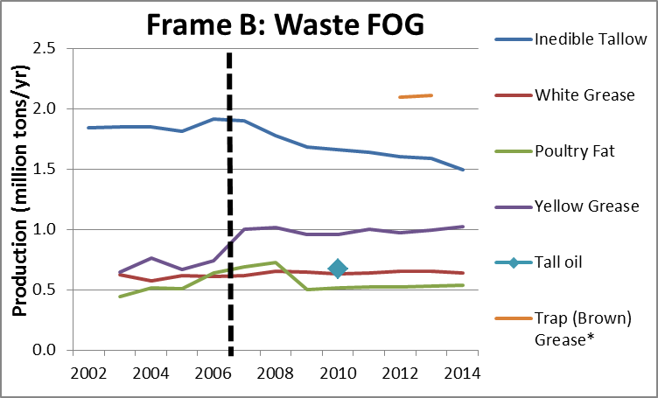
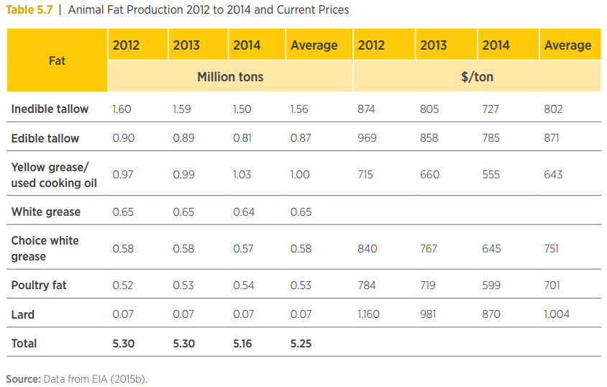
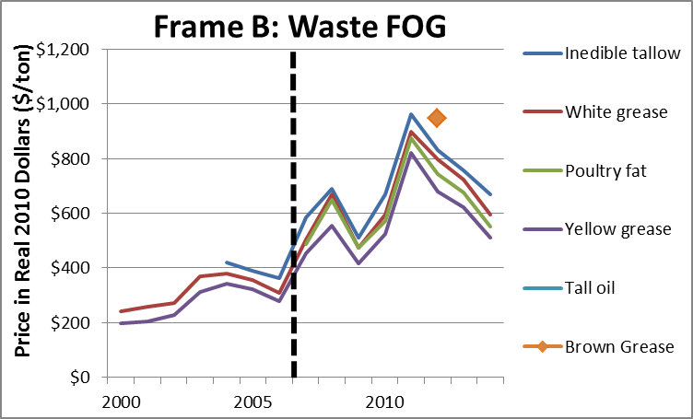
Feedstock Supply Curves
We plan to develop supply curves for the following feedstocks:
Fats, oils, and greases
Wastewater sludge
Animal manure
Food waste
FOG Historical Supply
FOG Historical Price

Slide 7
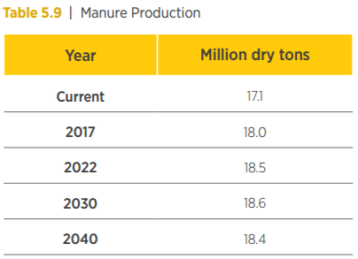
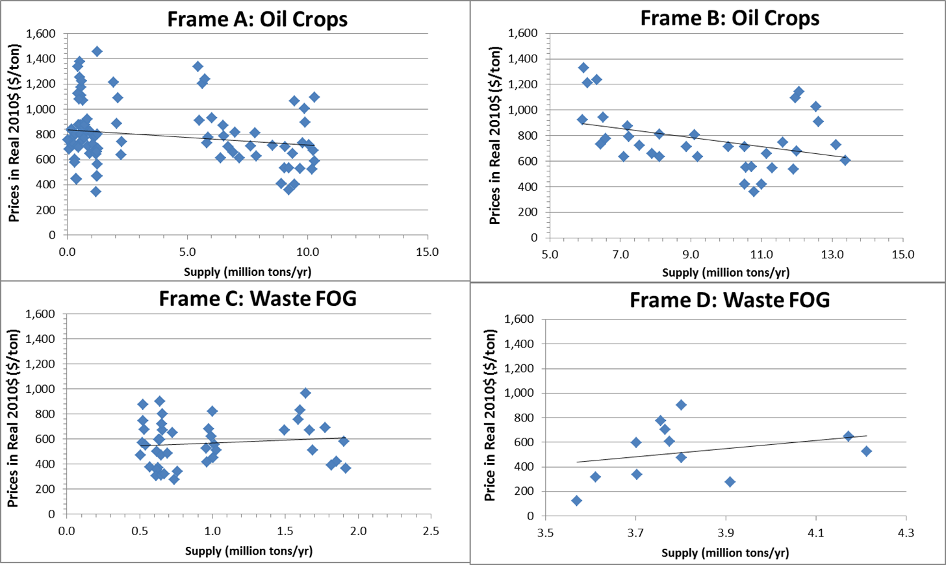
Feedstock Supply Curves (cont.)
Scope Questions:
What regionality is needed? Would it be different for different feedstocks?
What years are needed? (Billion Ton 2016 has $40, $60, or $80/dt for the years 2017, 2022, 2025, 2030, 2035, and 2040)
Each point represents production and price for a feedstock in a single year
Data NOT Aggregated
Aggregated Data by Feedstock Type
Source: Frame C and D – NRA Market reports [5-11]

Slide 8
Feedstock Supply Curves (cont.)
Relationship Questions:
What impacts projections of production?
Food waste/Wastewater - population
FOG - rendering and animal production and meat production/population (yellow and brown grease)
Animal manure - rendering and animal production and meat production
We should put questions in the presentation - consumption patters (vegetarianism), RFS
What impacts projections of price?
Fertilizer (manure/sludge can be converted into fertilizer - but high nitrogen), AD - electricity price, Tipping Fees;
Rendering - price of meat, consumption, plague (mad cow/bird flu), Tipping Fees
Food waste - Tipping Fees (landfills) - 60%, food banks - 2%, swine feeding - 0.2%, composting - 7%, incineration/AD for electricity or biogas (RFS) - the rest

Slide 9
Feedstock Supply Curves (cont.)
What impacts projections of price?
What impacts projections of production?
Food Waste
Population
Fertilizer Price
Animal
Manure
Rendering/Animal Production
End Use Price (All)
Meat Production
Tipping Fees (All)
Wastewater
Sludge
RFS (All)
Price of Meat
FOG
Consumption Patterns

